Slide 1
SOUKUP ROUTING
By: Mohamed A. Abdel Hamed

Slide 2
Outline
Purpose & Origin
Lee vs. Soukup
Variations of our Implementation
User Interface
References

Slide 3
Purpose & Origin
Soukup is a grid routing algorithm used in routing cells placed on a chip for a certain hardware design.
It is a variation of the Maze Router (Lee’s Algorithm) that was later called the Fast Maze Router.
Lee’s Algorithm is mainly a breadth-first search (BFS) Single Source Shortest Path (SSSP) on a cellular matrix.
Soukup is a combined approach that alternates between DFS and BFS to better Lee’s algorithm’s performance at expense of optimality.

Slide 4
Lee vs. Soukup
In the worst case scenario, Lee’s algorithm may need to visit almost every single cell on the grid if source and target are one main diagonal apart.
Lee’s algorithm uses a cost matrix that gets calculated for every net in order to look up cost of any cell.
However, Lee’s algorithm finds the optimal (shortest/least cost) path if at least one exists.
Soukup does DFS to go in a straight line towards the target until it hits an obstacle or starts going away from the target.
By going into a straight line, Soukup spares a lot of nodes (cells) that would’ve been visited by BFS, which speeds up performance, but ignore several paths that could have been less costly.

Slide 5
Lee vs. Soukup (cont.)
When Soukup hits an obstacle, it starts applying BFS to bubble its way around it in order to reach the next straight line towards the target cell (or reach it by bubbling directly).
Soukup, in principle, does not need a cost matrix, which can significantly reduce overhead of calculating it for every net. Nevertheless, it can be added to it to increase the optimality of the paths found.
Time Complexity of Lee’s Algorithm = O(NM) where N and M are the grid dimensions.
Soukup has the same Big-O time complexity, but is said to be from 10 to 50 times faster than Lee’s.
Though not optimal, Soukup guarantees a path if at least one exists.

Slide 6
Implementation and Variations
Presented is a Java implementation of Soukup’s algorithm using Java Swing for Graphical User Interface (GUI).
Our presented implementation performs routing in 3D with with metal layers (2 horizontal, 1 vertical) as opposed to the traditional 2D grid routing with only two metal layers (1 horizontal, 1 vertical)
To reduce code complexity, metal types used in the route were specified during the trace-back step after the route as been established to the target cell.
Adjacent metal tiles in the same direction are connect only if they belong the same route/net.
The program provides a feature to remove/rip the most recent route. It should be used with caution, however, for nets that have cells in common.

Slide 7
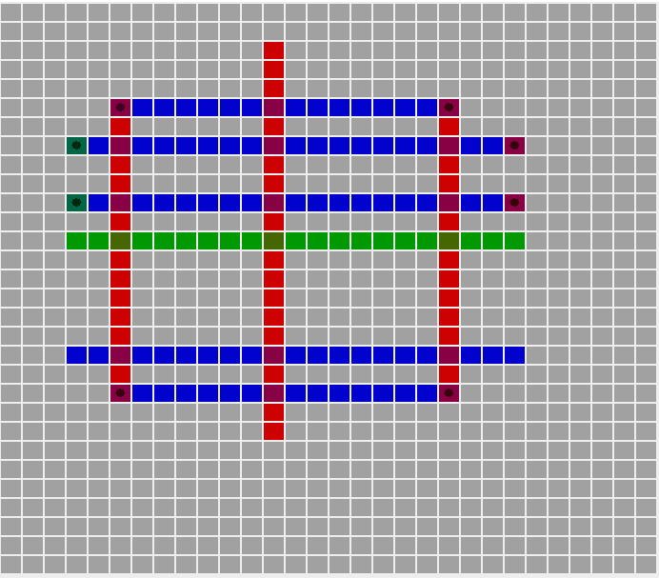
User Interface
Our presented implementation provides a graphical grid view along with the plain text view.
All inputs are taken through console.
Output results are presentable in both graphical and console views.

Slide 8




Legends:
Metal 1 (Horizontal)
Metal 2 (Vertical)
Metal 3 (Horizontal)
Via
Note the color transparency that indicates metal overlapping

Slide 9
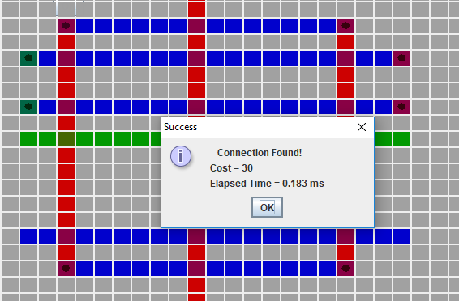
User Interface
It is advisable to place the console window alongside the GUI window in order to see the route as it’s drawn to avoid confusion with previous routes.
After constructing the route, the user can choose to view the plain text format of the grid for the three layers, which can be used to disambiguate the colored grid.
For each layer in plain text, 0 means no metal, 1 means metal tile, and 2 means metal with a via.

Slide 10
References
Soukup, J. I. R. I. (1978, June). Fast maze router. In Proceedings of the 15th Design Automation Conference (pp. 100-102). IEEE Press.
Dr. Shalan’s Slides

